Slide 2
Overview of pairwise structure superimposition tools
Basic concepts | 10 min
- Overview of the algorithms
- Scoring systems
Structural alignment | 15 min
- Sequence similarity searching
- Structure similarity searching + validation
Q&A | 5 min

Slide 3
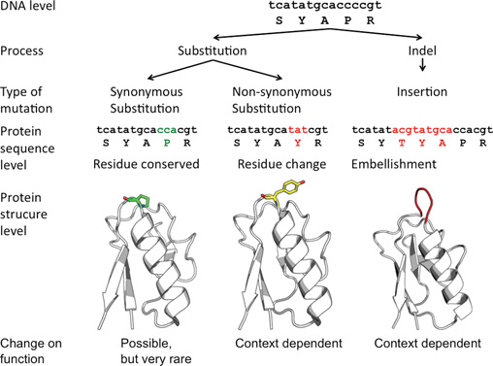
Studer RA, Dessailly BH, Orengo CA. Residue mutations and their impact on protein structure and function: detecting beneficial and pathogenic changes. Biochem J. 2013;449(3):581-594. doi:10.1042/BJ20121221

Slide 4
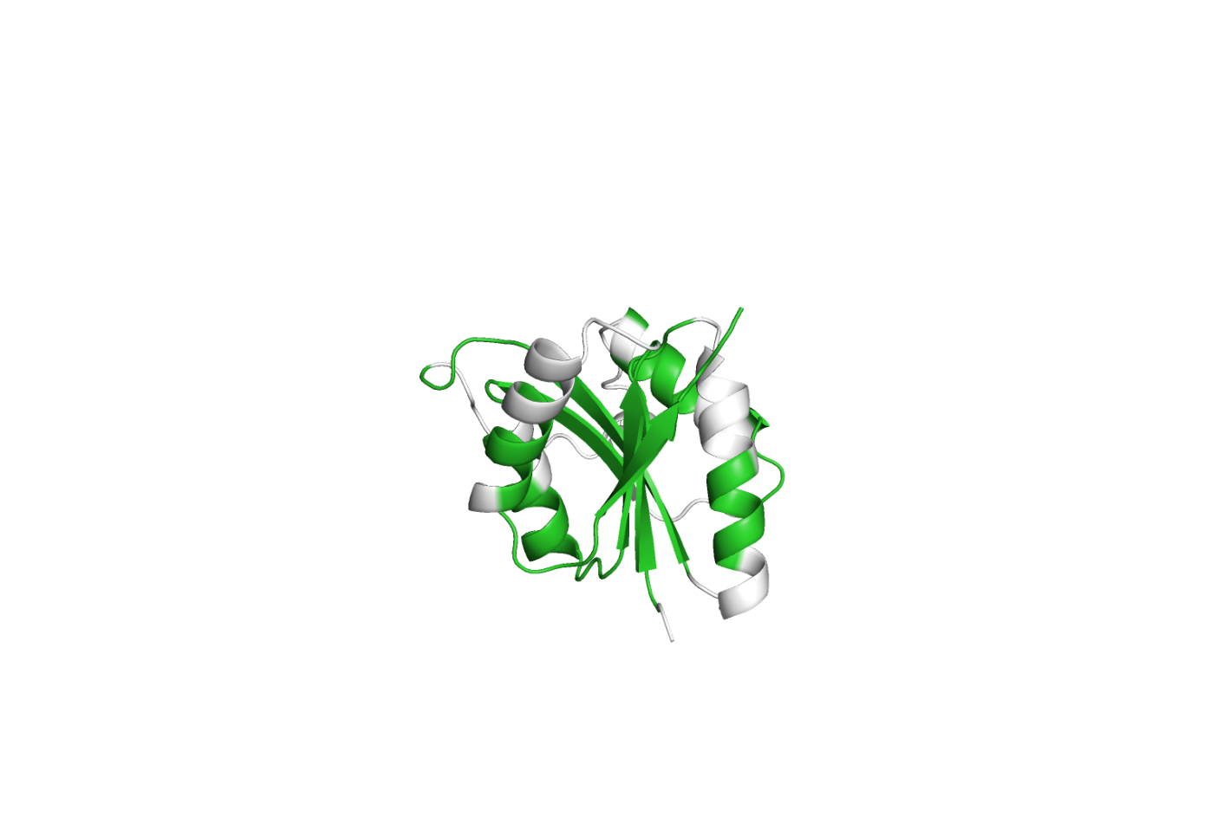
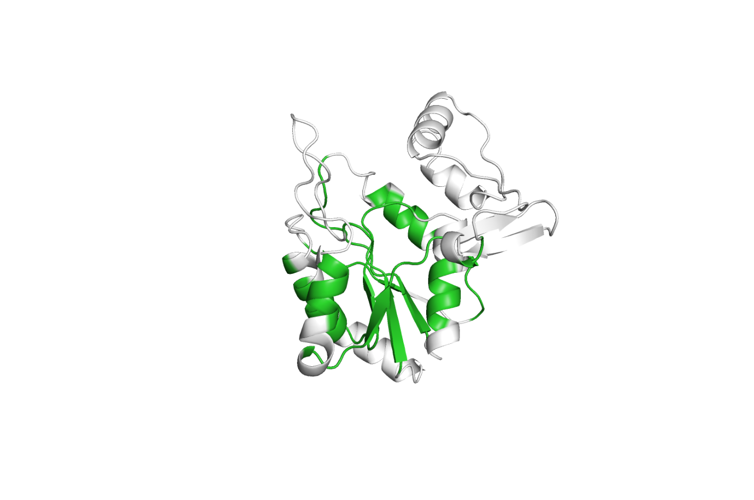
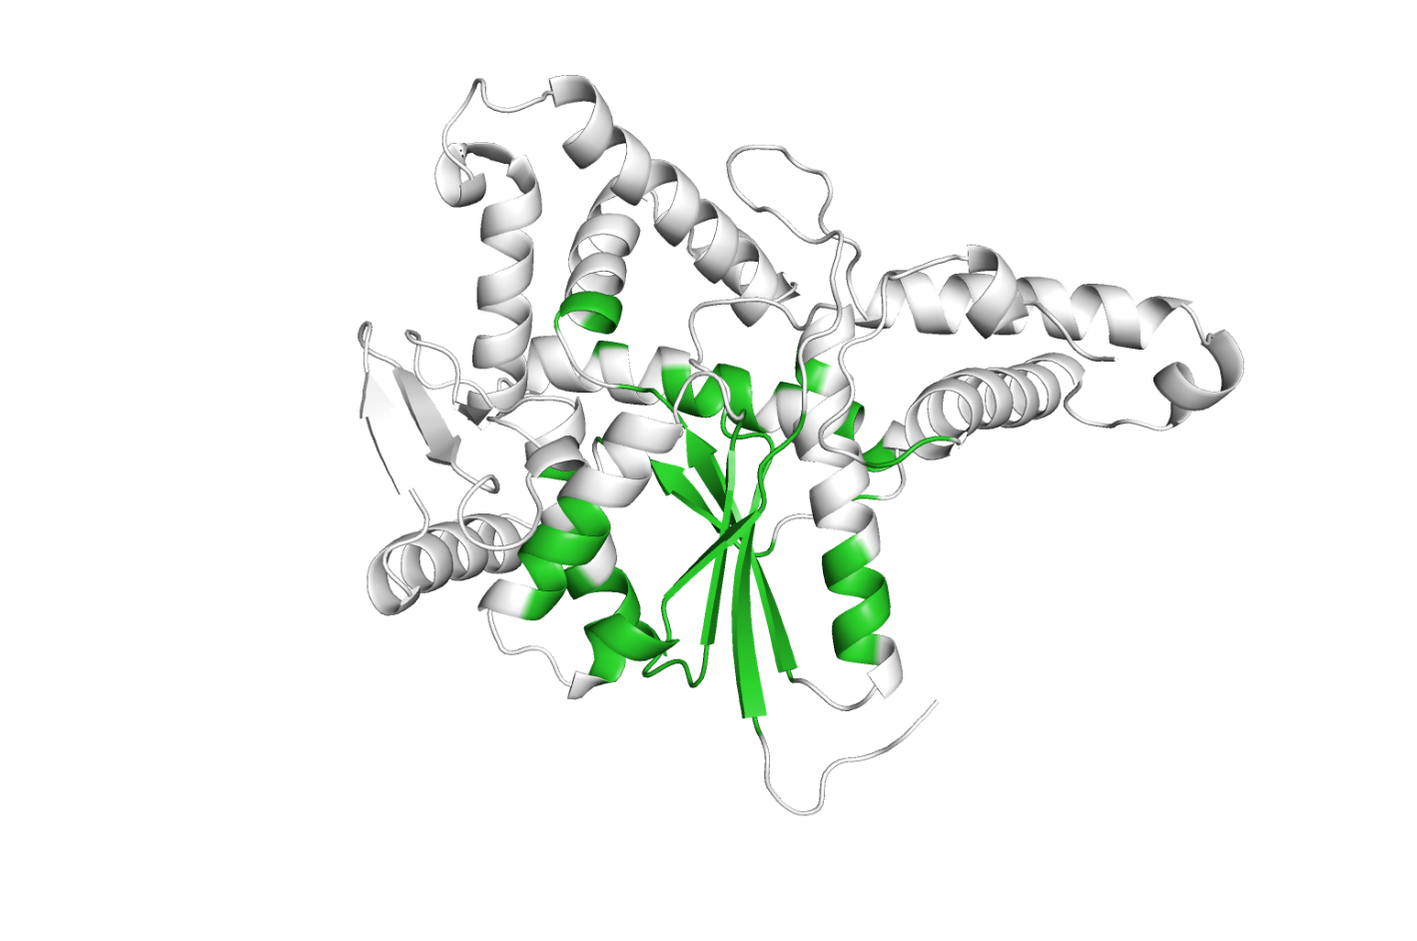
Structural diversity across a superfamily
Universal stress
protein A
Arginine tRNA ligase
Sulfate adenylyltransferase
HUPs Superfamily (3.40.50.620)

Slide 5
“Mega” Superfamilies
CATH currently has around 6,000 superfamilies…
0
6,000
CATH Superfamilies

Slide 6
“Mega” Superfamilies
CATH currently has around 6,000 superfamilies…
…but ~60% of all known protein domains
belong to only 100 of them
0
6,000
CATH Superfamilies
100
Protein Domains
60%
Notes:
Where structures are diverging, functions are diverging as well.
We want to group them together so we can understand evolutionary relationships and functional changes.

Slide 7
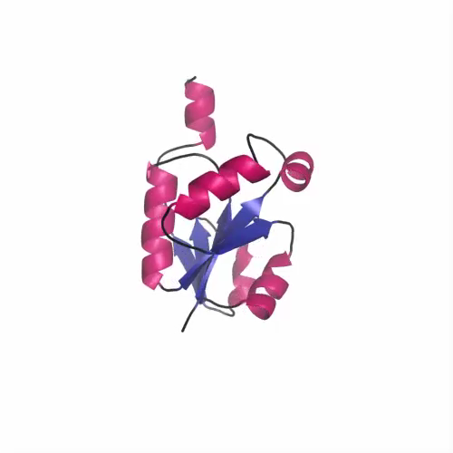
(Even divergent) CATH superfamilies contain well-conserved structural cores

Slide 8
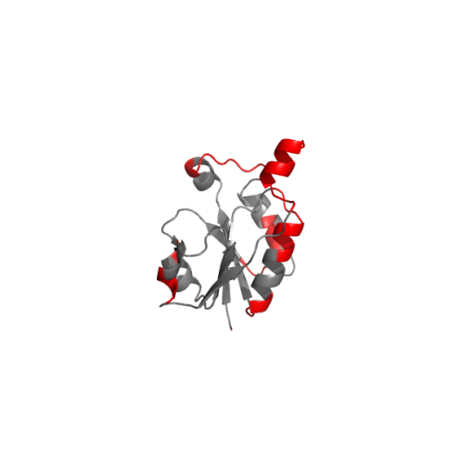
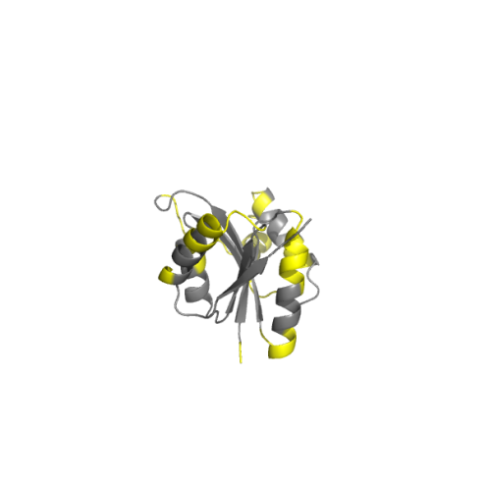
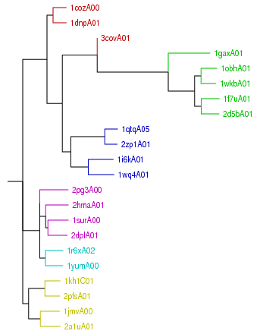
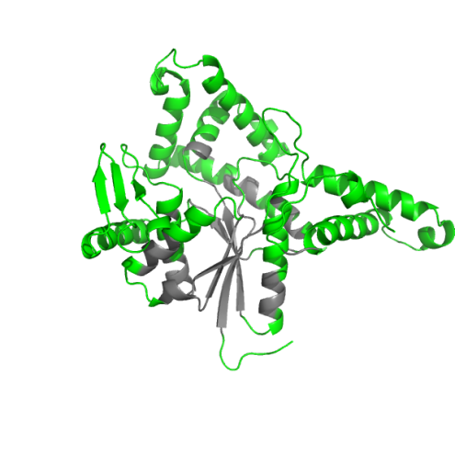
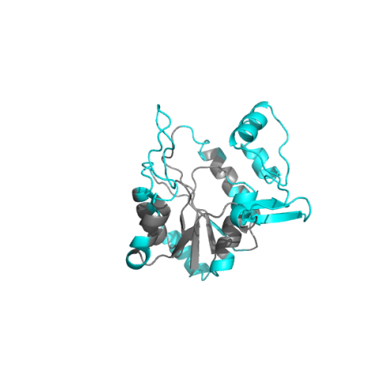
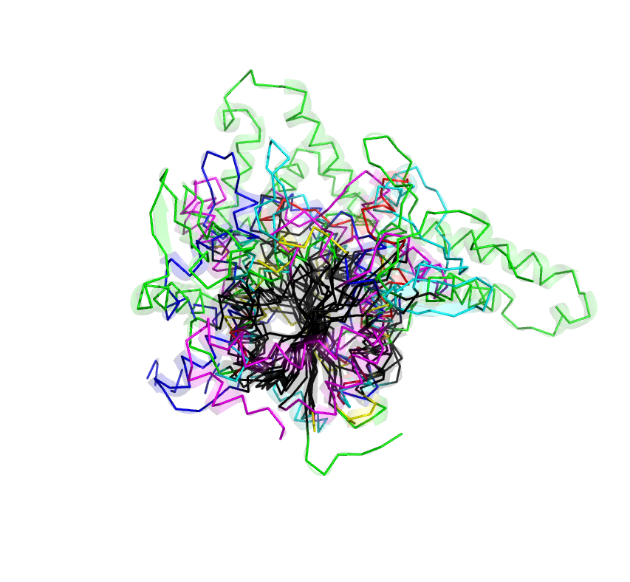
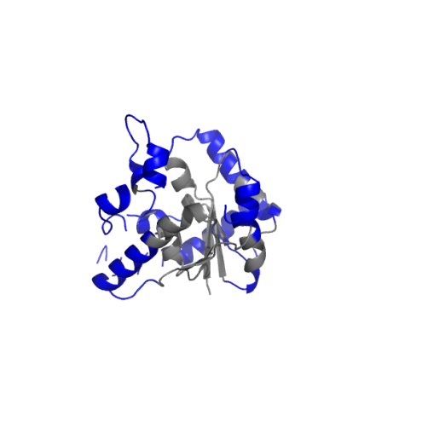
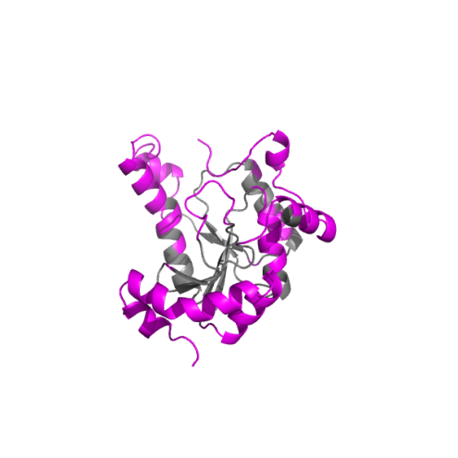
HUP CATH Superfamily
1
2
1cozA00
1jmvA00
SSG 1
SSG 4
Structurally Similar Groups (SSGs)
Structural Clusters (SSGs)
3
6
5
4
1f7uA01
1r6xA02
SSG 2
SSG 5
1i6kA01
1surA00
SSG 3
SSG 6
Notes:
8

Slide 9
Adding Sequence Data to CATH
Structure / Sequence Data
450,000 CATH structural domains
90,000,000+ known protein sequences
Lots of those sequences have useful experimental annotation
Gene3D
Build sequence models from structural domains
Search these models against database of genome sequences (HMMER3)
Identify CATH domains within genomic sequences

Slide 10
Gene3D: domain structure annotations in genome sequences
Scan all protein sequences against library of HMMs representing superfamilies
hmmer3
Protein sequences from completed genomes and UniProt
Scan against library of HMM models and sequences for:
> 90 million domain sequences assigned to CATH superfamilies
CATH
Pfam
Notes:
Add in agglomerative clustering slides

Slide 11
Gene3D: domain structure annotations in genome sequences
cath-resolve-hits: matches to CATH domains take precedence
N
CATH-1
C
Pfam-1
Pfam-2
NewFam
CATH-1
NewFam
Pfam-2
Multi-Domain Architecture (MDA)

Slide 12
CATH, Pfam and NewFam coverage of genomes
Per sequence
Per residue
CATH
Pfam
NewFam

Slide 13
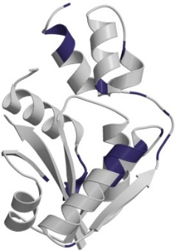
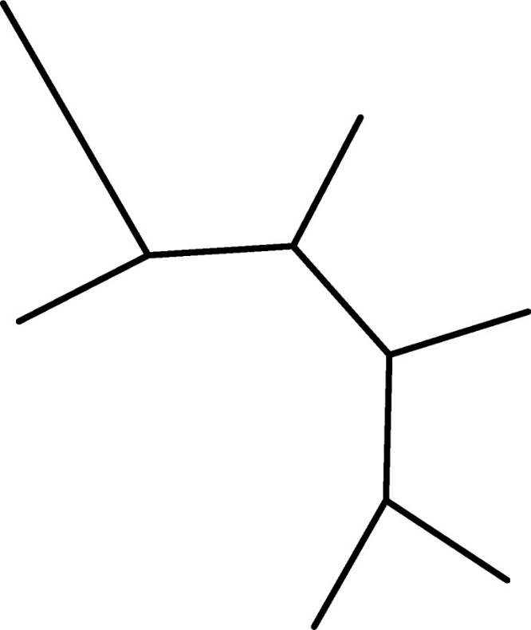
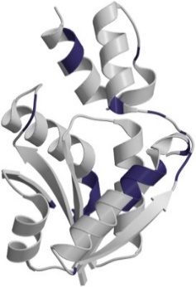
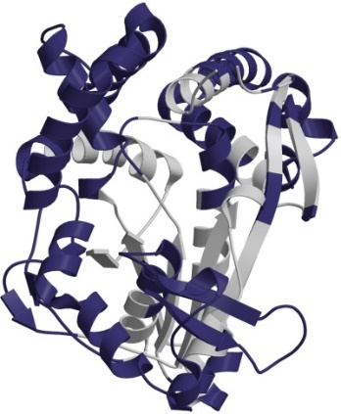
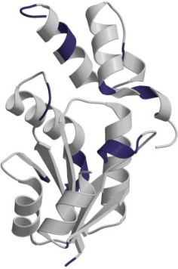
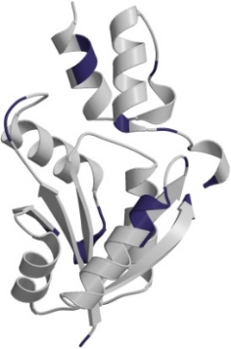
HUP Domain Superfamily
Domain Superfamily
human
yeast
human
Homologues
M. tuberculosis
Th. thermophilus
Notes:
Orthologues come from speciation. They are much more likely to conserve their structure and they tend to have similar functions.
Paralogues are more challenging to detect.

Slide 14
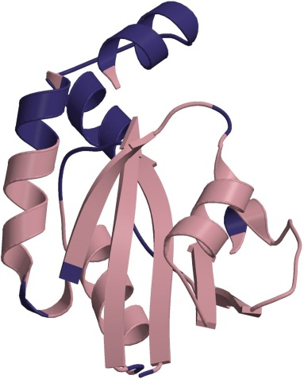
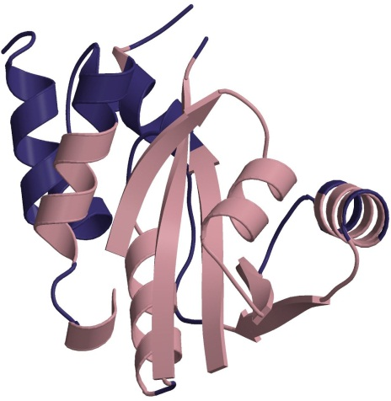
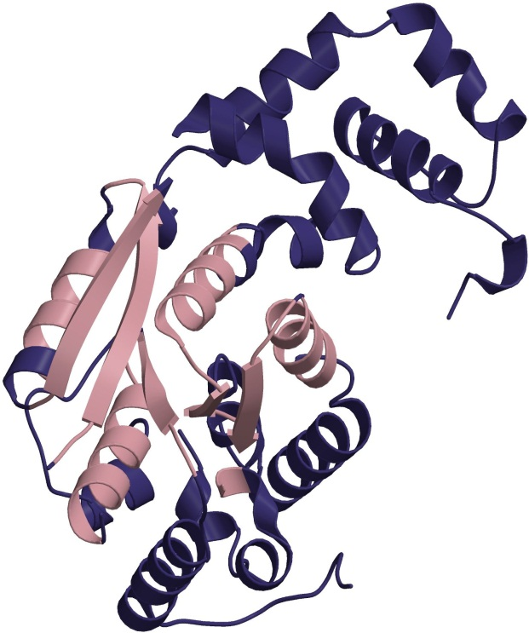
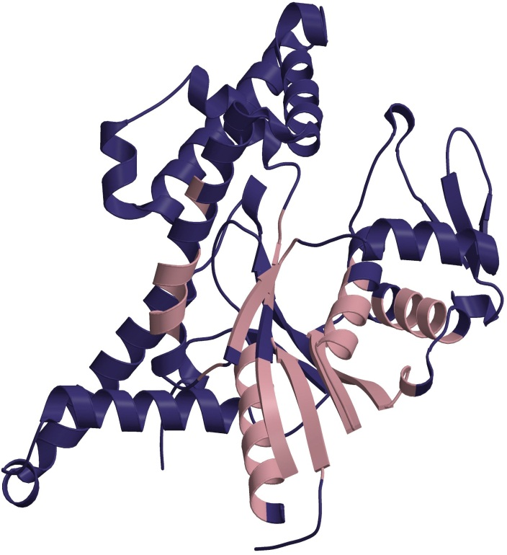
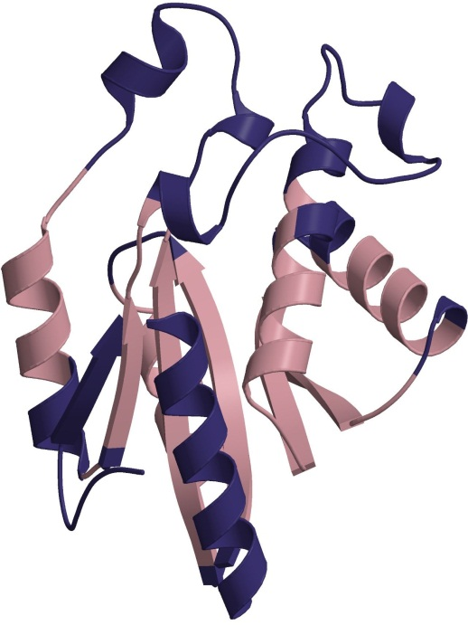
HUP domain superfamily
243 structures
34,568 sequences
244 GO molecular function terms
Glycerol-3-phosphate cytidylyltransferase
Phosphopantetheine adenylyltransferase
Pantoate -
β-alanine ligase
Arg-tRNA synthetase
Asn synthetase B
Notes:
Structure changes mediate function changes

Slide 15
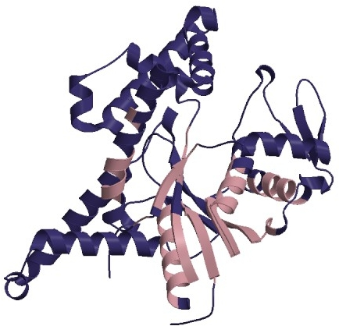
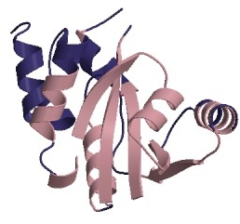
binding site
Pantetheine-phosphate adenyltransferase
Arginyl-tRNA synthetase
Changes in the domain structure can modify the binding site
Notes:
15
Structural embellishment changes the shape of the active site

Slide 16
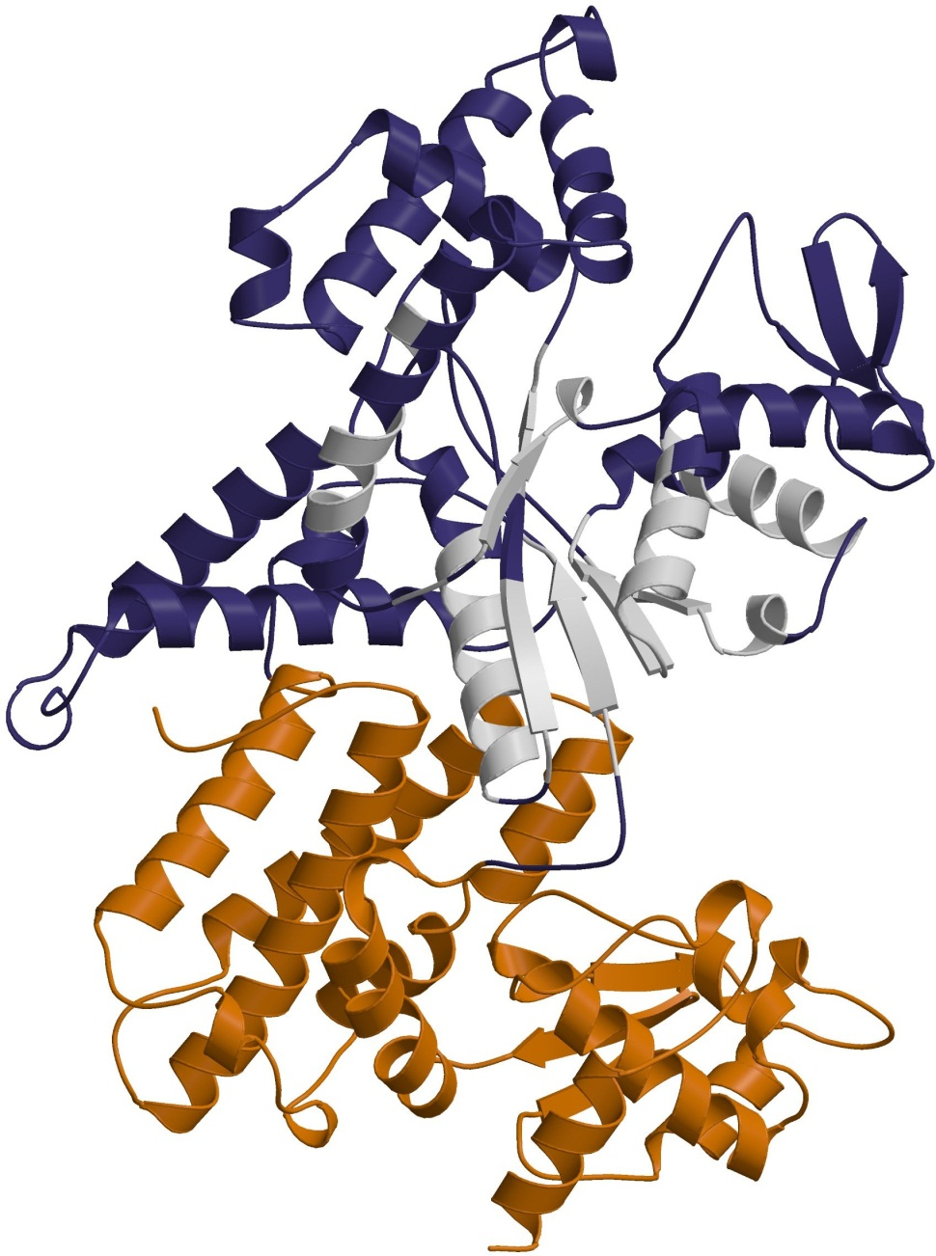
Arginyl-tRNA synthetase
Notes:
Pocket changes and the interaction changes

Slide 17
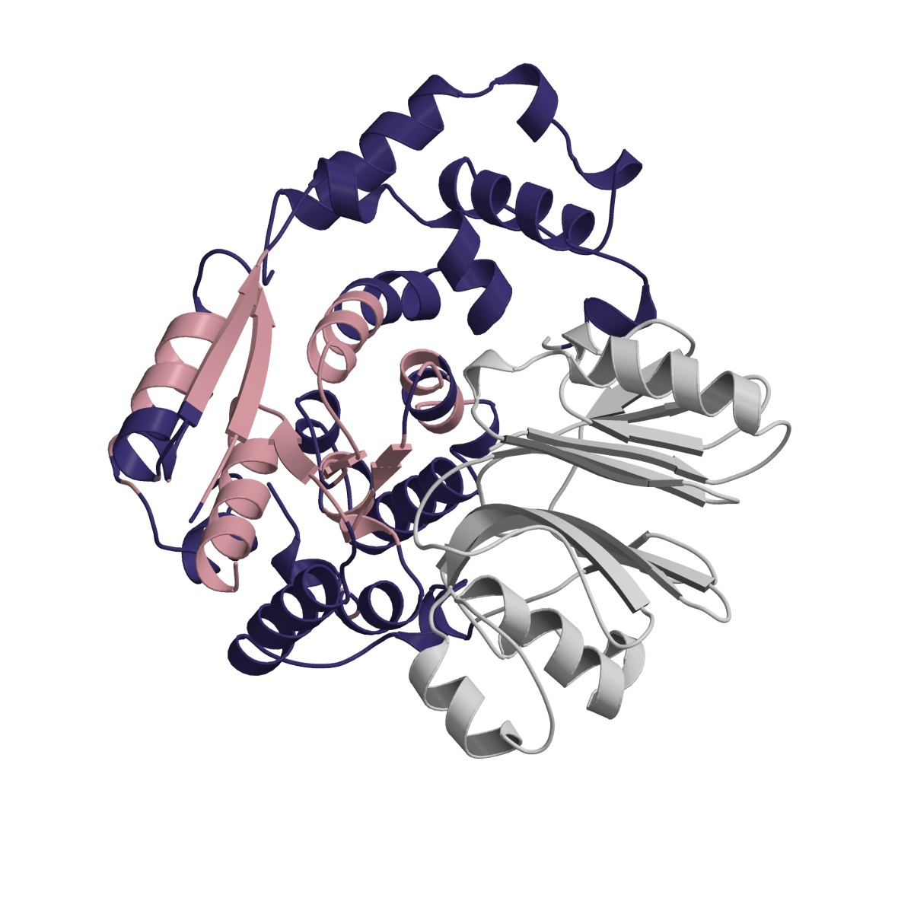
changes in the domain partnerships can modify the binding site
binding site
Pantetheine-phosphate adenyltransferase
Asparagine synthetase B
159 different domain partners
(identified using predicted multi-domain architectures in Gene3D)
Notes:
Structural changes mediating a new domain interaction
Enable the packing of a new domain, which changes the active site.

Slide 18
Mutations in Functional Residues
binding site
Notes:
18
Sometimes there are very small changes within a binding site

Slide 19
Function?
Domains in a CATH Superfamily may have evolved to perform many different functions
To make predictions about function, we need functionally “pure” clusters
Notes:
When people use CATH they don’t just want to know about structural superfamily, they want to know about the function.
There’s not enough structural data to partition the superfamily into functions.
That’s why we’ve got a strategty that looks for sequence motifs that correlate with function.

Slide 20


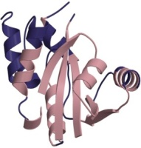
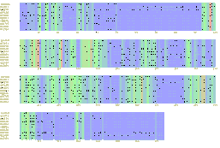
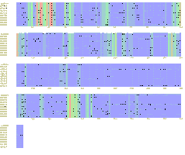
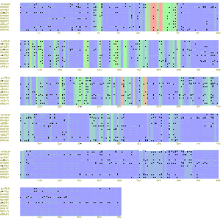
Functional Families (FunFams)
CATH-Gene3D Superfamily
Each colour denotes a unique function/sub-function
Functional Family 1
Functional Family 2
Functional Family 3
Functional Family 4
Lee et al. NAR (2009), Rentzsch et al. BMC Bioinformatics (2013), Redrovag et al. Nature Methods (2013) , Sillitoe et al. NAR (2015), Das et al. Bioinformatics (2015)
Notes:
Add in new FunFam slides from Christine

Slide 21

Functional Families (FunFams)
Function 1
Function 2
SUPERFAMILY
Function 3
Function 4

Slide 22

Specificity Determining Positions (SDPs)
Conserved Positions
ACPRLDVDSAQ
ACPR-EVDCAV
GCPRIEVDSAR
GCGRIEVDSAD
ACGKLEIDAIP
ACAKLE-DCIP
GCRKKELDAIP
FunFam 1
FunFam 2
Specificity Determining Positions
Das et al. Bioinformatics (2015)
Notes:
Completely conserved are probably folding and packing
Really interested in finding differentially conserved sites.

Slide 23
How do we know if they work?
Do the FunFams correspond to what we already know about functionally important residues?
Can we use them to predict functional annotations (blind test)?

Slide 24
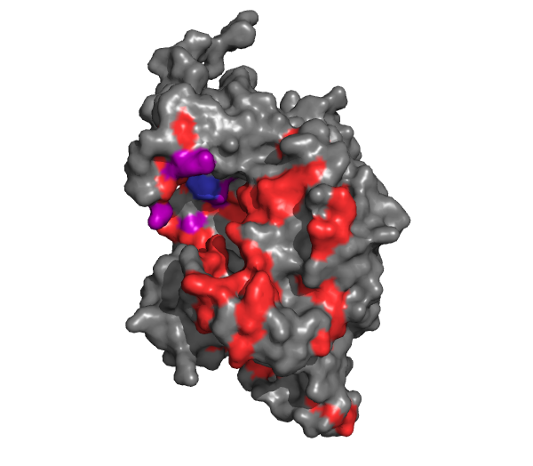
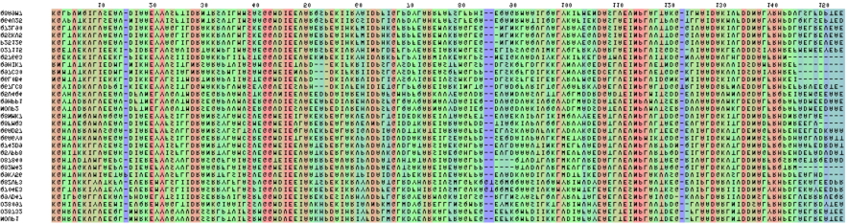
FunFams are structurally and functionally coherent
Active Site
(CSA)
Highly conserved alignment positions (scorecons)
Multiple Sequence Alignment of FunFam
Residues in contact with a protein partner
(IBIS)
Dessailly et al., Biochim Biophys Acta. (2013)
Notes:
See that predicted sites are very highly enriched in known functional site information.

Slide 25
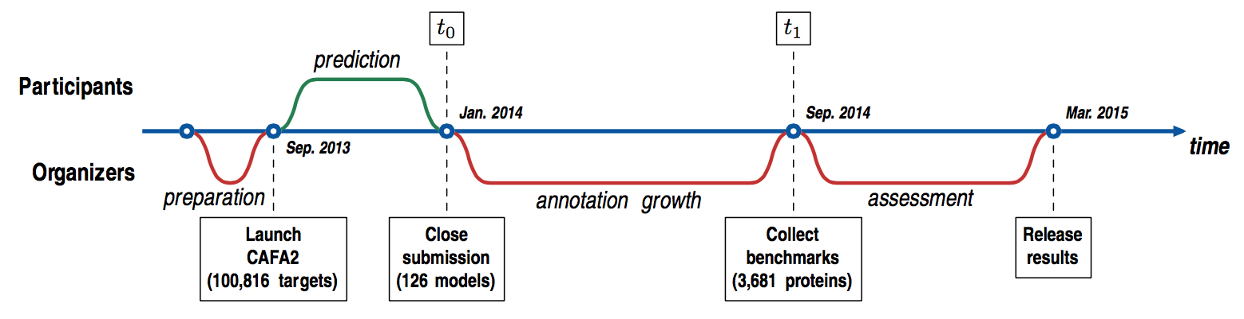
CAFA
Assessment of automated function prediction methods
3,681 unannotated protein sequences (from 18 species)
126 methods provided predictions of functional annotation
Results assessed independently
“An expanded evaluation of protein function prediction methods shows an improvement in accuracy.”
- The CAFA Consortium, Genome Research 2015
Notes:
Results validates the purity of these functional partitions

Slide 26
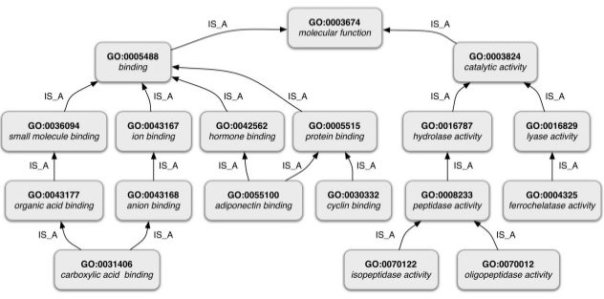
Functional Annotation
GO: Semantic Distance

Slide 27
Functional Annotation
GO: Semantic Distance

Slide 28
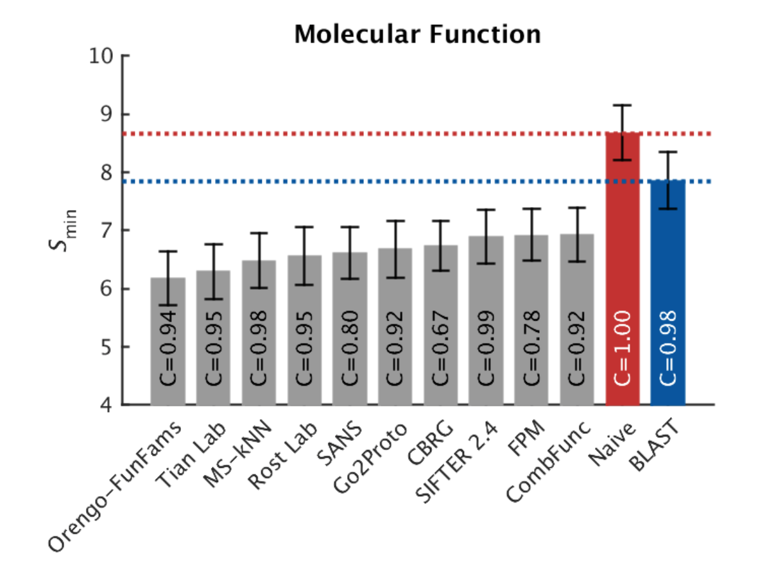
CAFA2
Notes
Predict GO annotations for novel sequences
Comparing predicted vs real
Only showing top 10 methods (of 126)

Slide 29
CAFA Summary
CATH FunFams perform well
Results have improved from CAFA 1 and 2
Long way from a perfect science
Currently predicting GO terms from sequence most useful for filtering large scale studies (eg metagenomics)

Slide 30
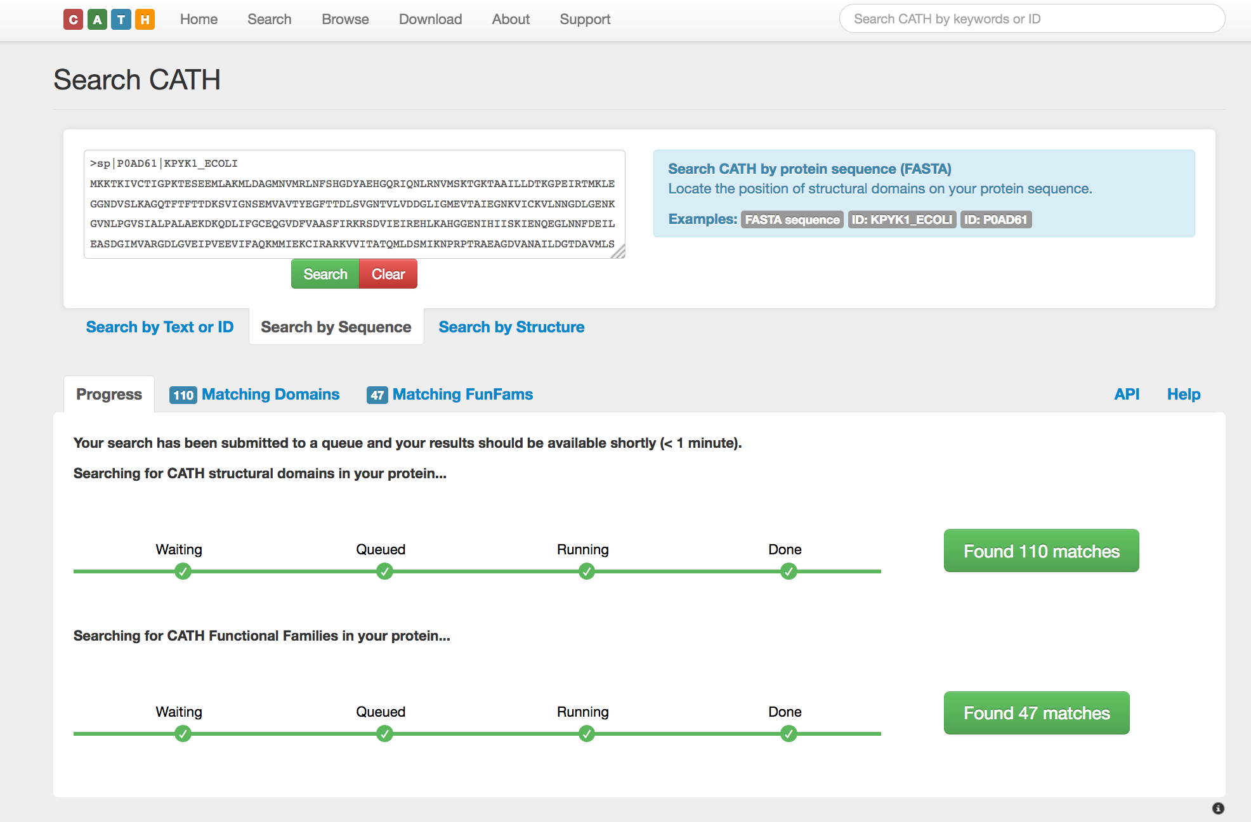
CATH Sequence Search: FunFHMMer
Sillitoe, I. et al., Nucleic Acids Research (2014), Das, S. et al. Bioinformatics (2015)

Slide 31
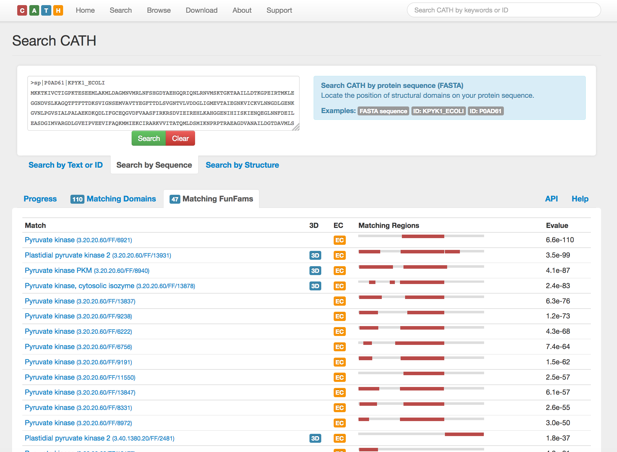

Slide 32
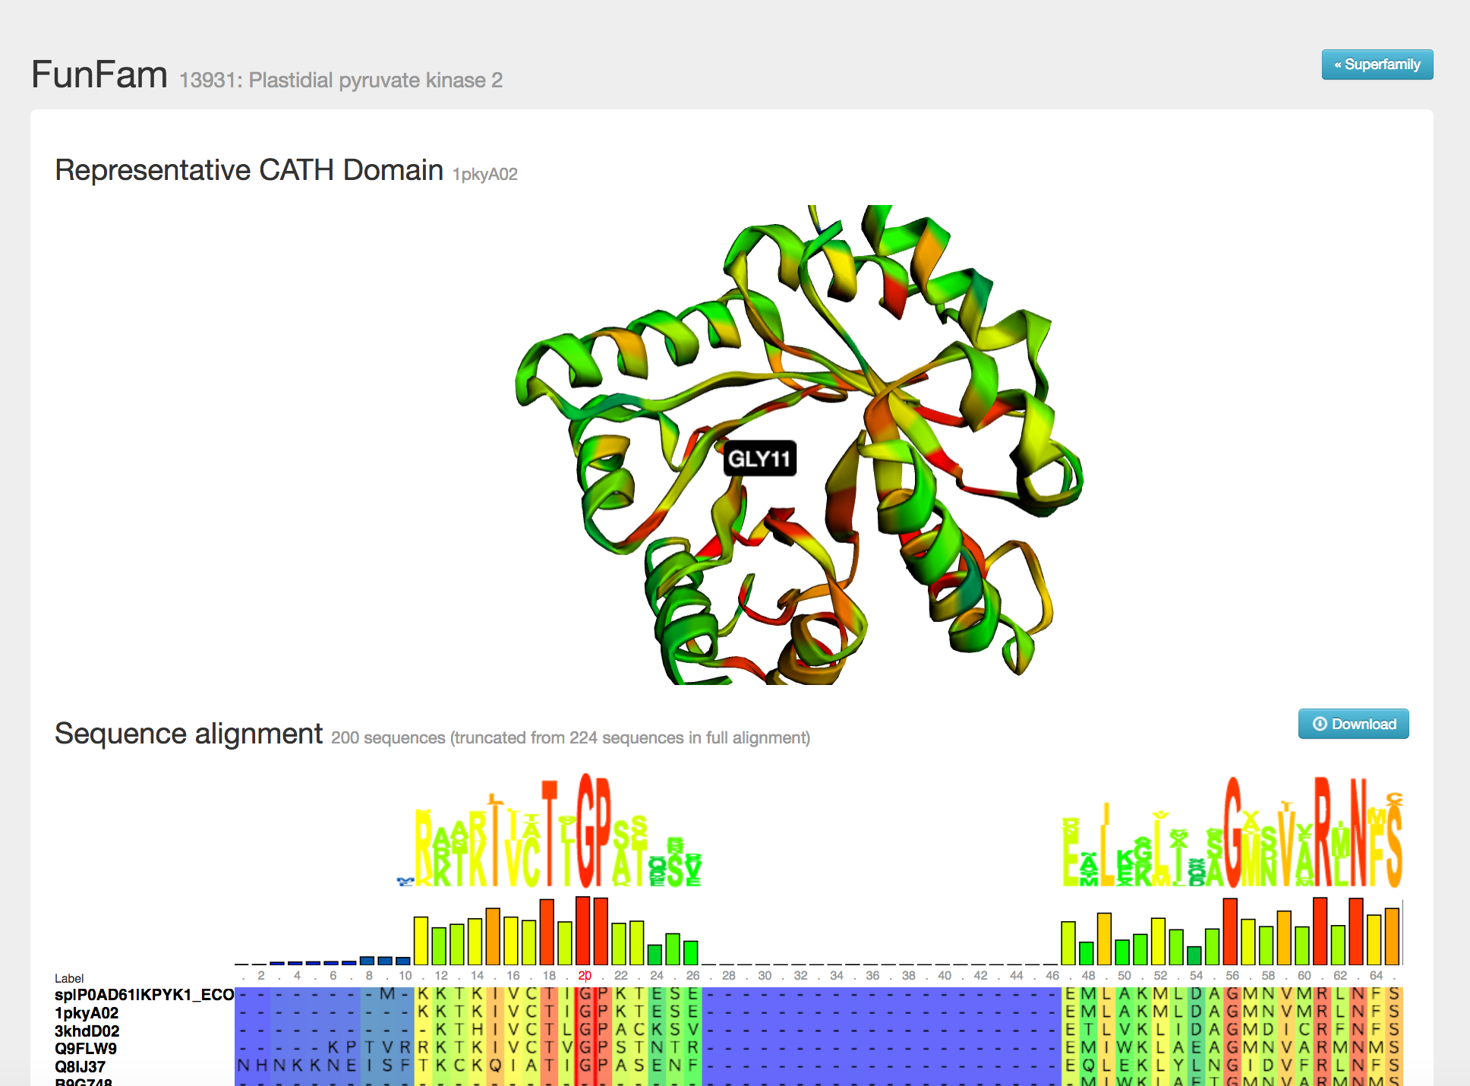

Slide 33
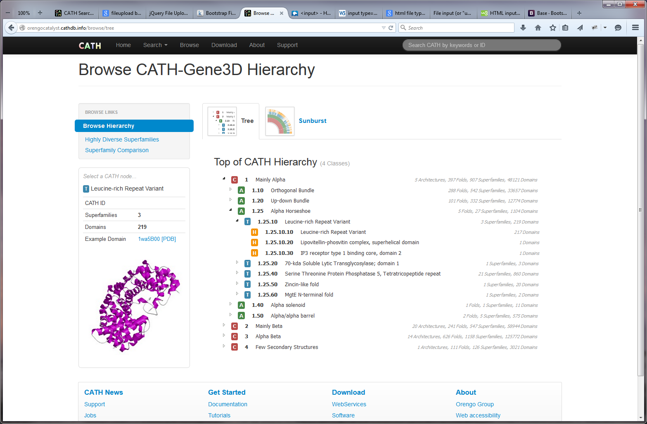
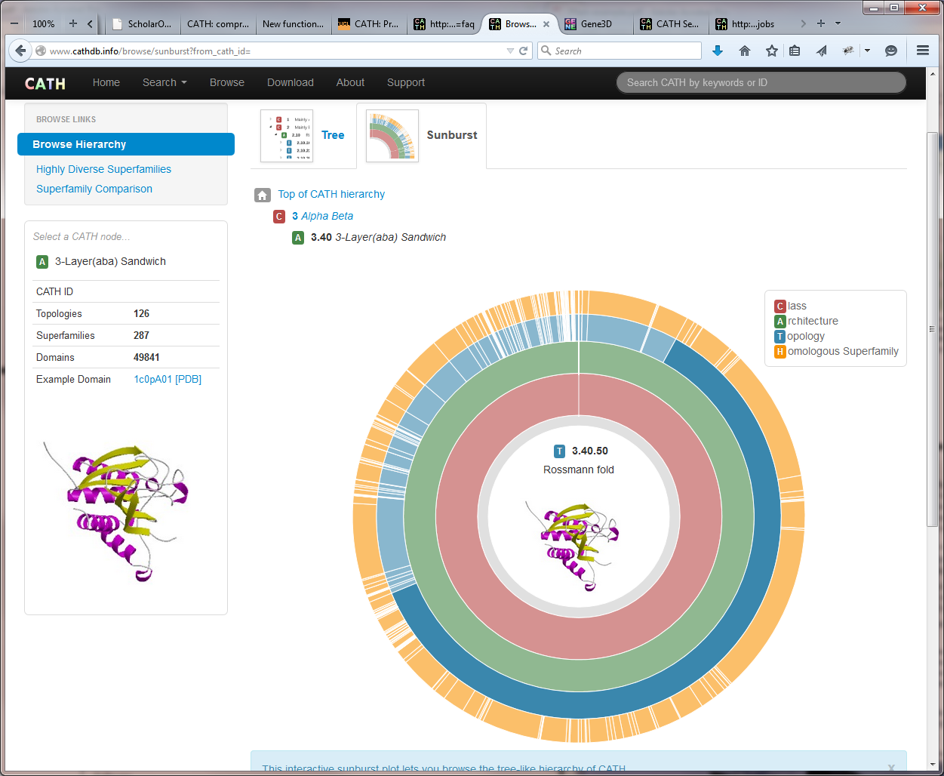
Browsing the hierarchy on the CATH website
Notes:
More CATH superfamily screen shots

Slide 34
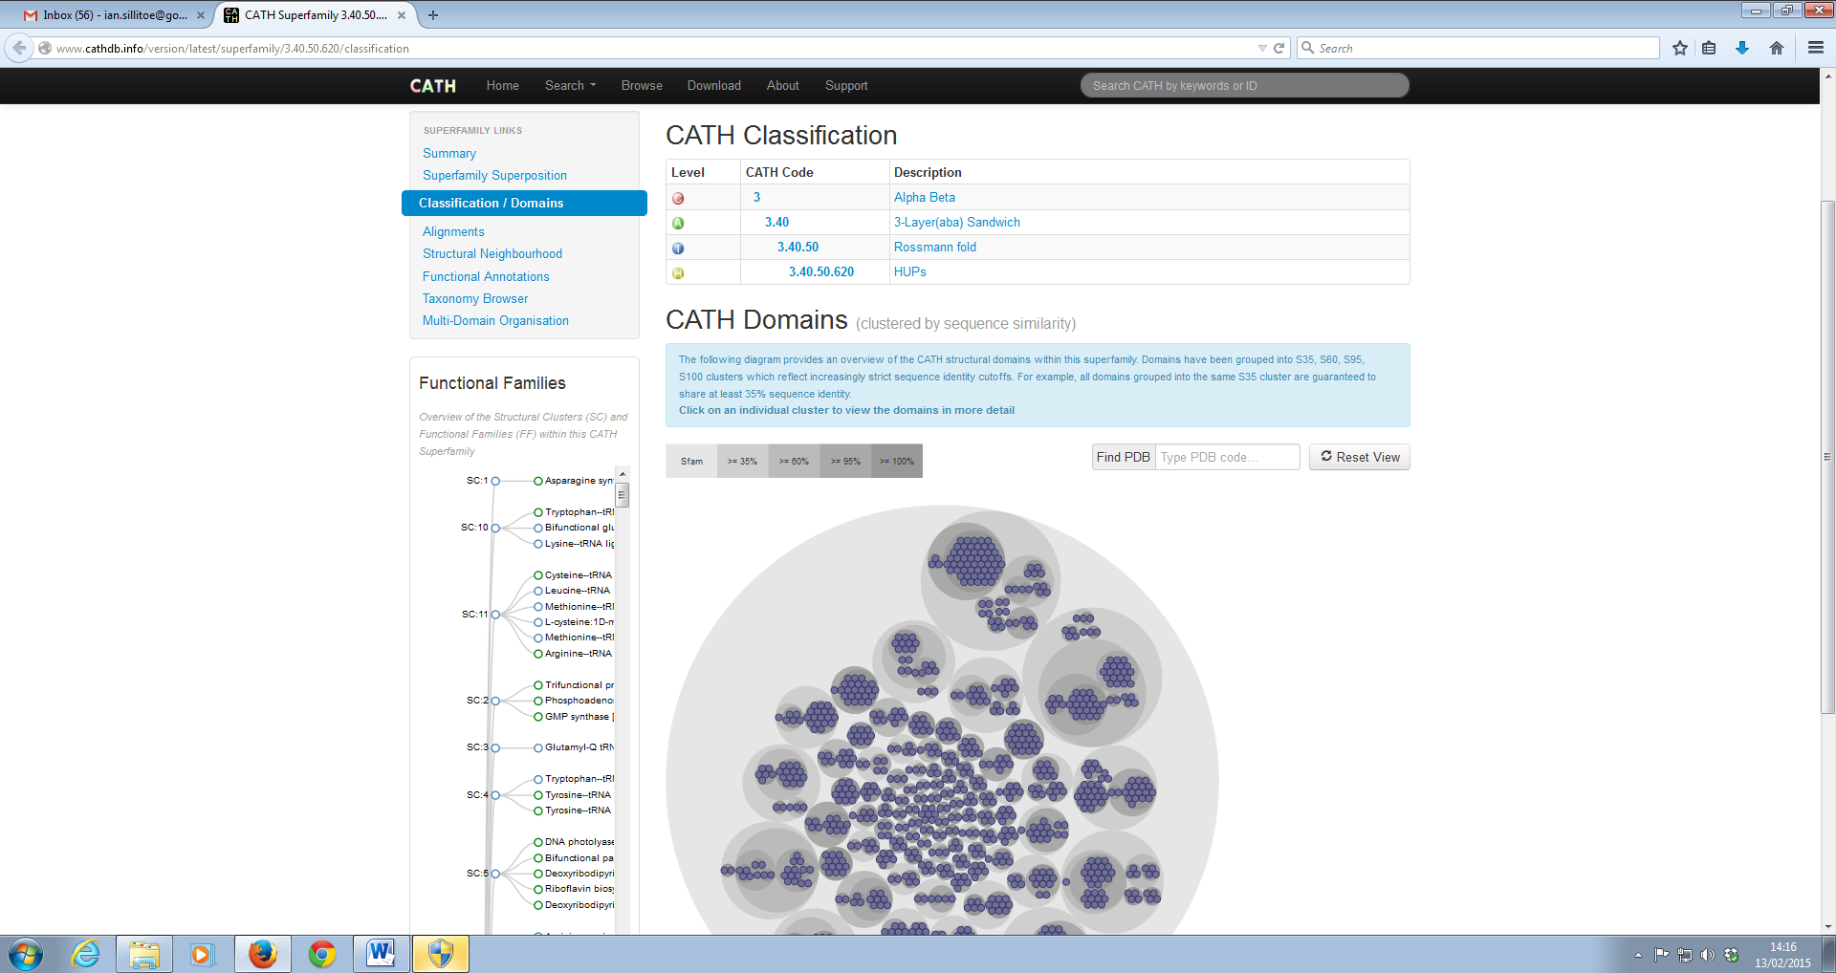
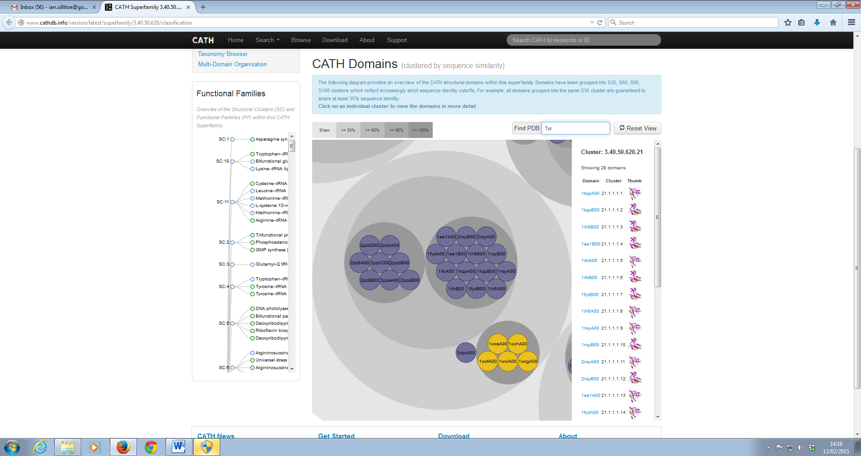
Sequence similarity of domains on the CATH web pages

Slide 35
CATH: Useful Data
CATH-B
CATH-20 | CATH-40
cath-tools (GitHub)
Access very latest PDB annotations
Updated daily
Includes automatic and manual annotations
Expect few changes when released
Download non-redundant structural domains
Datasets similar to ASTRAL
Non-redundant at:
< 20% seq id
< 40% seq id
Available as:
Classification lists
PDB
Robust, well maintained, open source software
Align / superpose protein structures
Resolve sequence scans into domain architectures
Scan genomes offline
www.cathdb.info
www.cathdb.info
UCLOrengoGroup/cath-tools

Slide 36
Genome3D
Annotating Genome Sequences
With 3D Structure

Slide 37
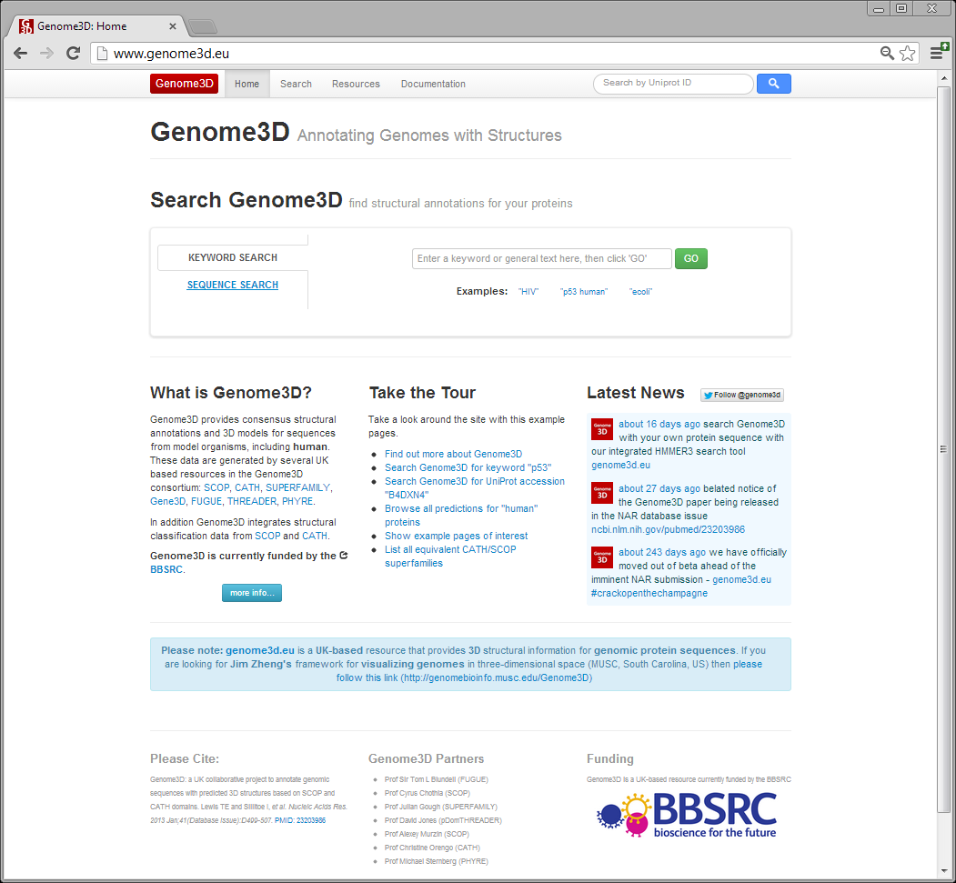
Notes:
- Numerous improvement to web site based on feedback from Julian, Mike, Ioannis (and others)
- made search box most prominent feature of front page
- added NAR citation, contact email and BBSRC logo to footer of all pages

Slide 38
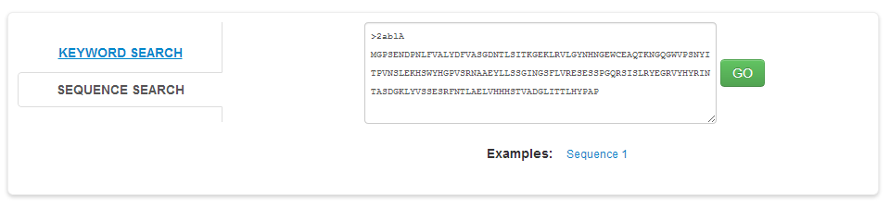
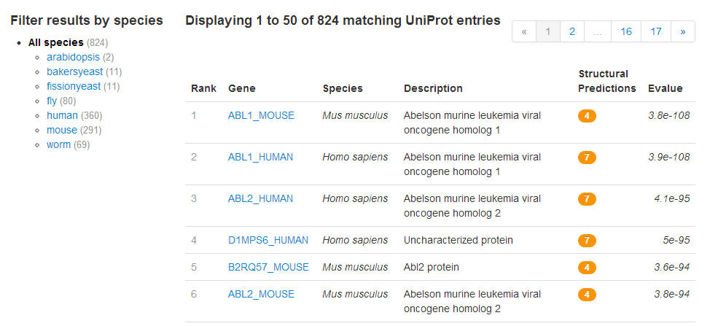
Search
Notes:
- Implemented HMMER3 search
- Improved free text search
- Results can be filtered by species

Slide 39
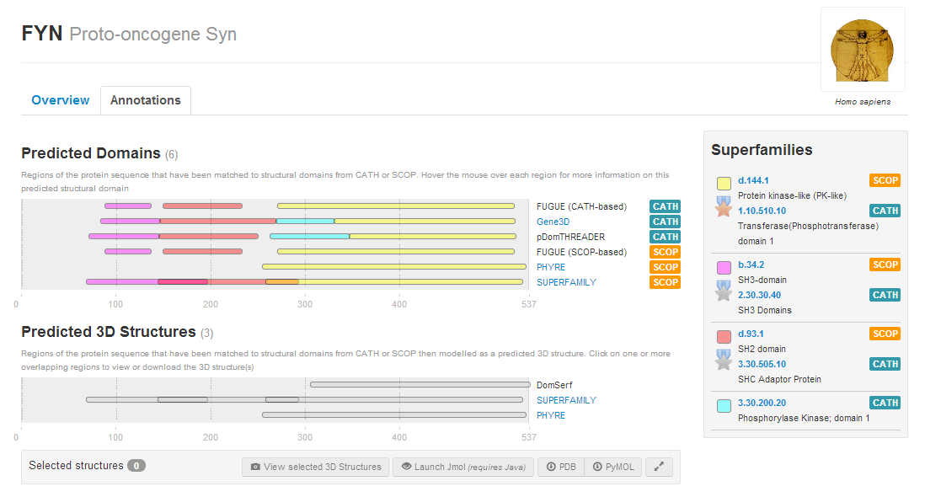
Notes:
Reminder of what the annotation page looks like
Highlighting the future changes to the 3D visualisation section

Slide 40
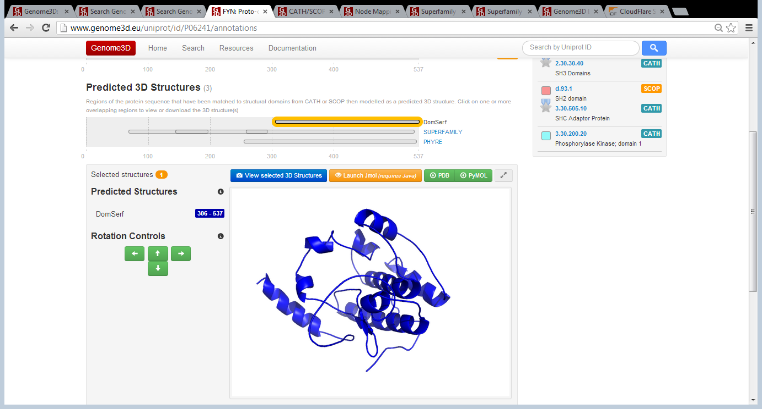
3D View: Images / J(S)Mol / PyMOL
Notes:
- Image auto-updates whenever the domain selection is changed (takes ~2-5 seconds to render on-the-fly)
- Working as proof of concept
- Needs further testing and minor improvements before releasing

Slide 41
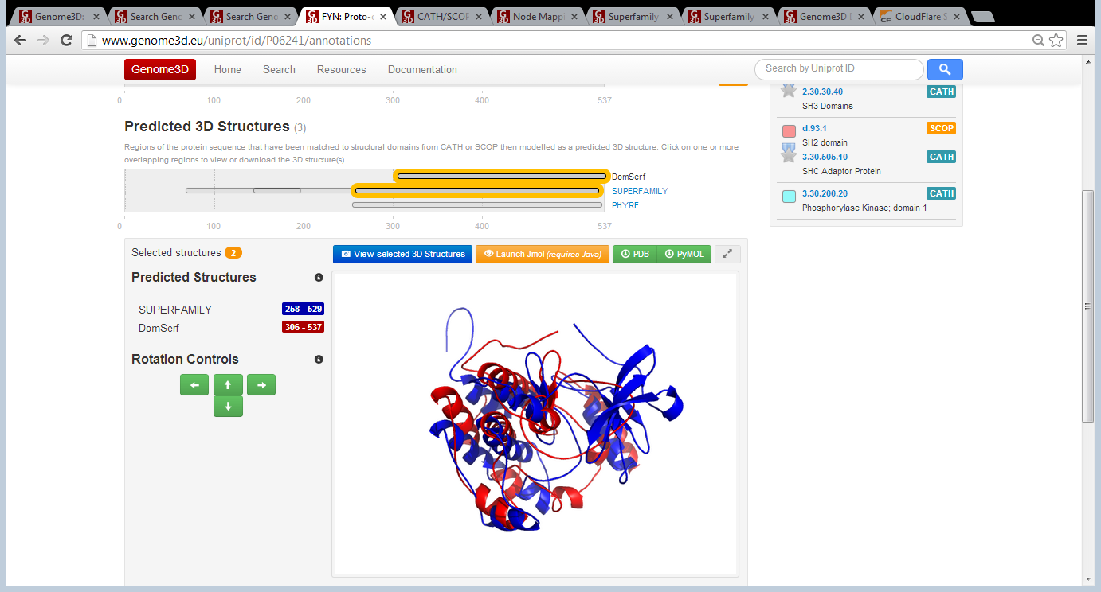
3D View: Images / J(S)Mol / PyMOL

Slide 42

3D View: Images / J(S)Mol / PyMOL

Slide 43
Notes:
Reminder of what the annotation page looks like
Highlighting the future changes to the 3D visualisation section

Slide 44

CATH / SCOP Mapping

Slide 45
Summary
CATH Superfamilies
Curated evolutionary relationships
CATH FunFams
Clusters of functionally similar domains
FunFHMMER
Predict structural domains and function from sequence
Genome3D
Consensus structural annotations of model genomes
i.sillitoe@ucl.ac.uk

Slide 46
Acknowledgements
Orengo Group
Genome3D
Others
Christine Orengo
Ian Sillitoe (CATH)
Tony Lewis (CATH)
Natalie Dawson (CATH)
Paul Ashford
Georgios Baskozos
Sayoni Das
Aurelio Moya Garcia
Su Datt Lam
Dave Lee
Jon Lees
Millie Pang
Alexey Murzin (SCOP)
Antonina Andreeva (SCOP)
Sameer Velankar (PDBe)
Nurul Nadzirin (PDBe)
Tom Blundell (Genome3D)
Julian Gough (Genome3D)
David Jones (Genome3D)
Mike Sternberg (Genome3D)
Janet Thornton (EBI)
Roman Laskowski (EBI)
Nick Furnham (FunTree)
Frances Pearl (CATH)
James Bray (CATH)
Oliver Redfern (CATH)
Alison Cuff (CATH)
BBSRC
Wellcome Trust

Slide 47
Tutorial
CATH-Gene3D
www.cathdb.info
-> About -> Tutorials -> “A Tutorial on CATH and Gene3D”
Genome3D
www.genome3d.eu
-> Tutorials -> CATH / Gene3D
Questions, Comments, Bugs, Features
GitHub “cath-todo”

